Slide 1
MULTI-CUT REBAR(16)
Advisor : Prof. K.C.Chang
Presenters : You-Ran Nai
Notes:
Try 講清楚脈絡

Slide 2

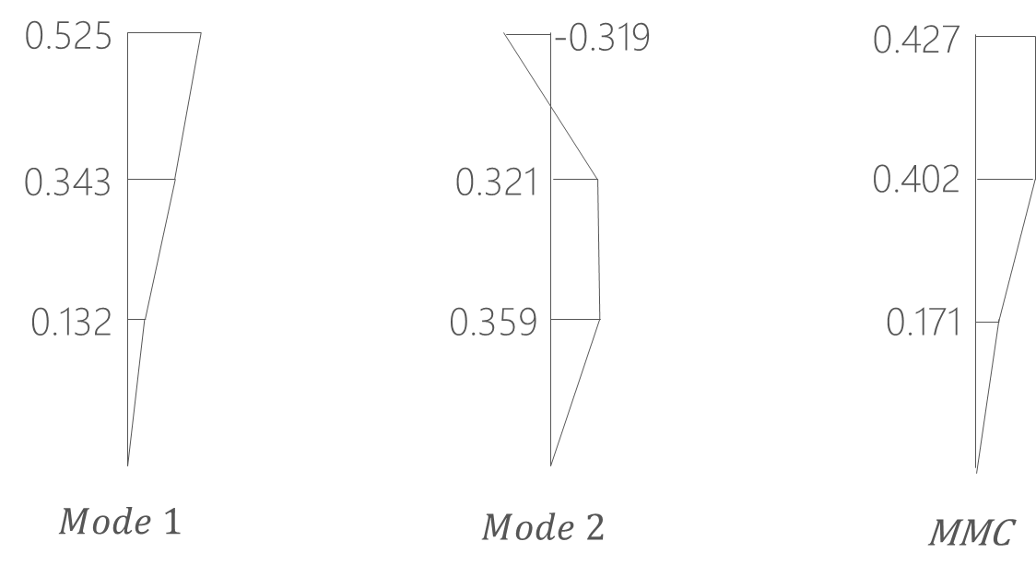
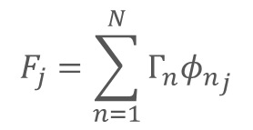
Pushover Load Pattern
Triangle
Multi-Modes Combination
Modal Pushover Analysis
$$F_{j}=\sum_{n=1}^{N}{Γ_{n}{φ_{n}}_{j}}$$
SRSS
Notes:
定義非線性驗證的邊界

Slide 3
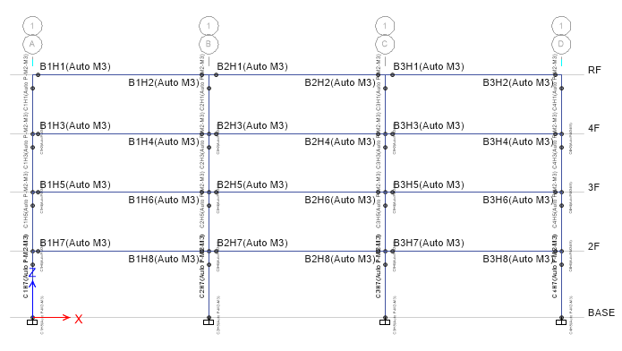
Hinges Only On Two Ends

Slide 4
Modal Pushover Analysis

Slide 5
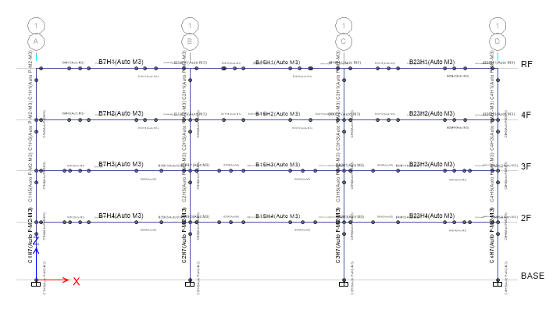
Multiple Hinges

Slide 6
Modal Pushover Analysis

Slide 7
Multi-Modes Combination

Slide 8
Normal NoLd
Ra=1.57
R=1.76

Slide 9
Ra=1.72
R=1.93
Ra=1.77
R=1.98
Ra=0.3
R=0.36

Slide 10
Normal Side
Ra=1.56
R=1.74

Slide 11
Ra=1.61
R=1.80
Ra=1.66
R=1.84
Ra=0.3
R=0.36

Slide 12
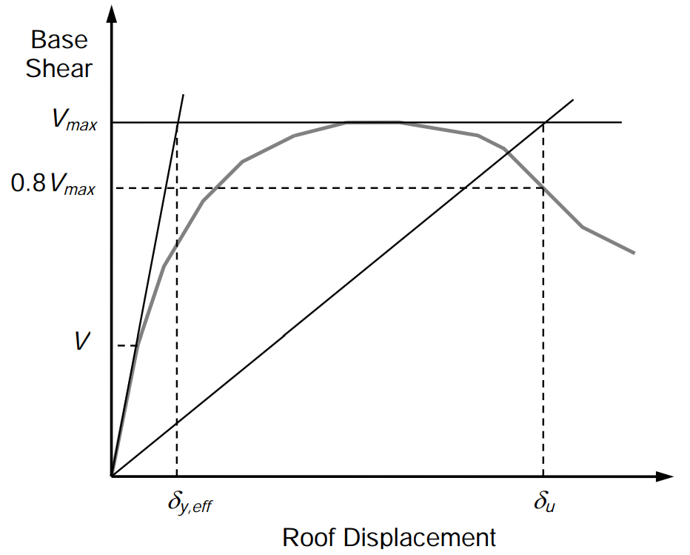
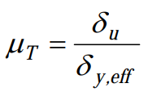
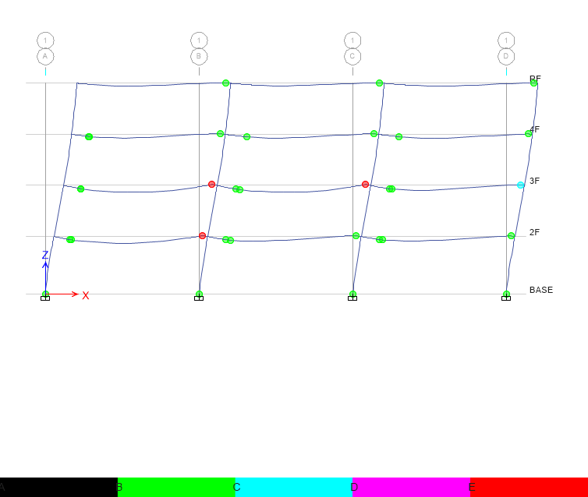
Pushover Result
Hinge
Notes:
比較 Ra, R 值
DBE, MCE 的性能績效點對應到 delta_u
雙線性化找到 delta_y,eff

Slide 13
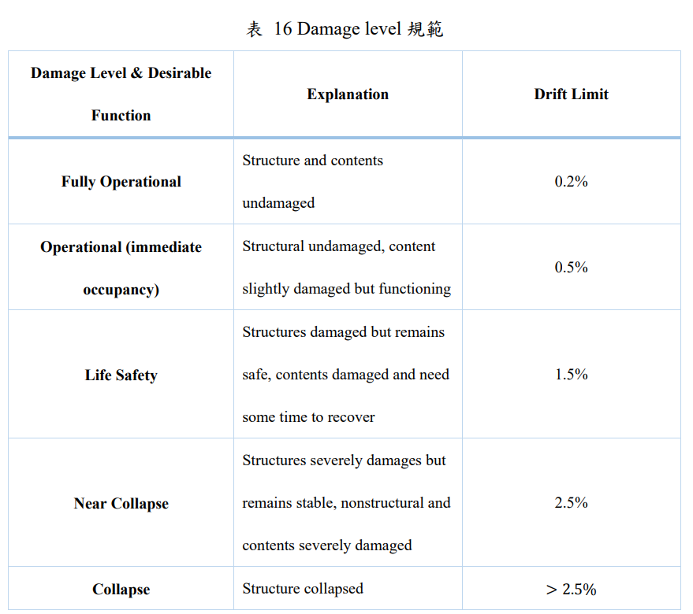
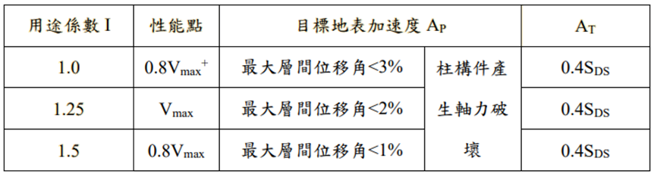
Pushover Result
耐震性能檢測 PGA
ATC-40

Slide 14
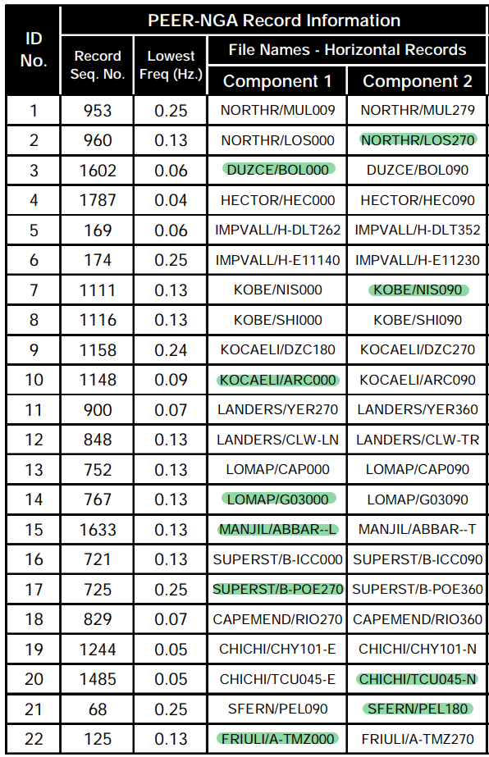
Time History
Find PGA and PGV
Calculate $\frac{PGA}{PGV}$ ratio
Min 10 ratio and no same earthquake

Slide 15
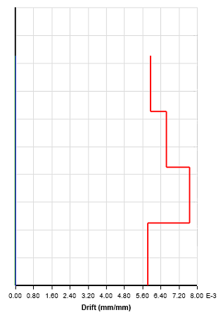
Time history
Story Drift
Scaled to DBE, MCE
DBE < 1.5%
MCE < 2%

Slide 16
Scaled

Slide 17
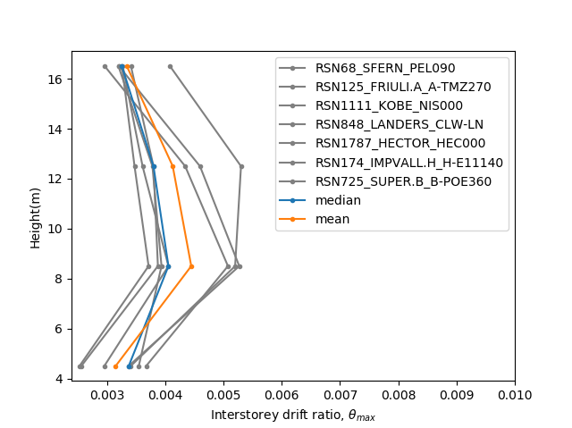
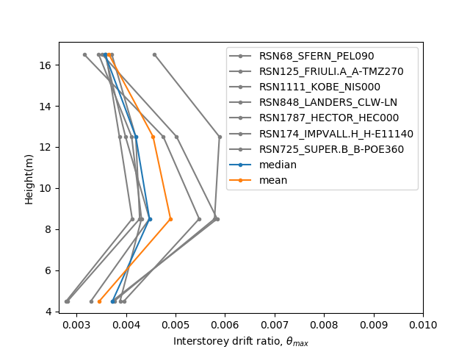
Hinges Only On Two Ends

Slide 18
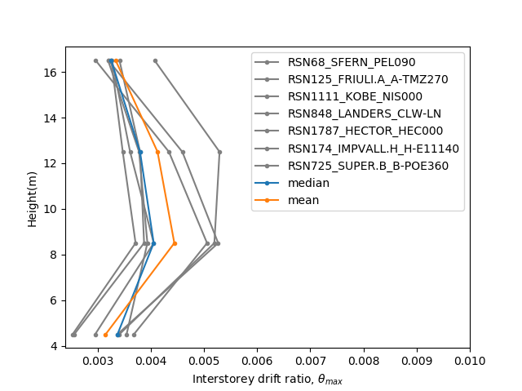

Multiple Hinges

Slide 19
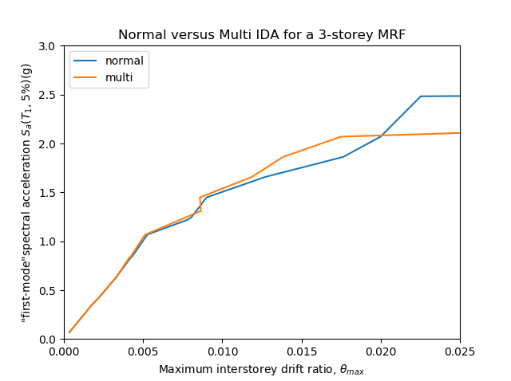
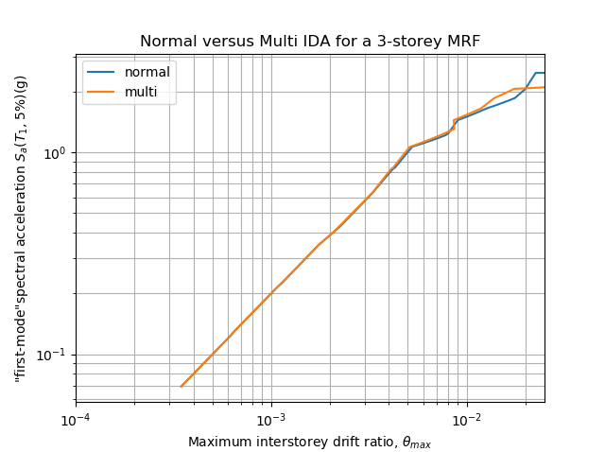
IDA
Limit-State
4% FEMA273
2.5% SEAOC 2000

Slide 20
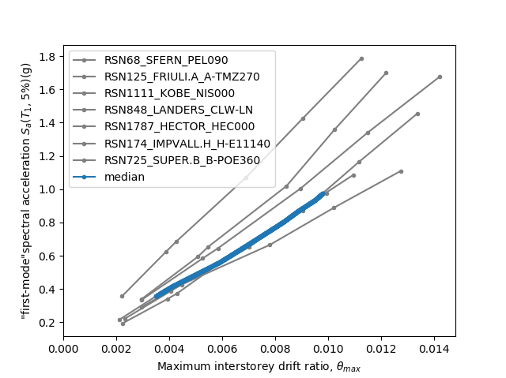
Hinges Only On Two Ends

Slide 21
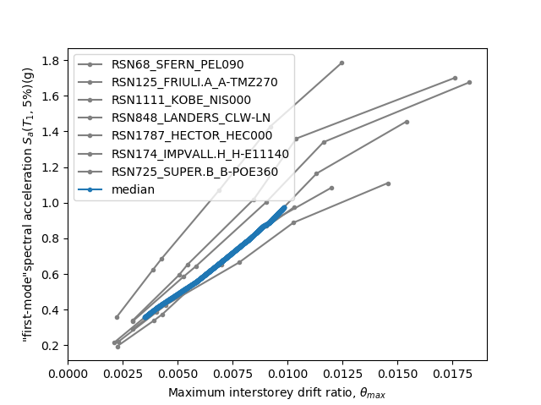
Multiple Hinges

Slide 22

Normal NoLd

Slide 23
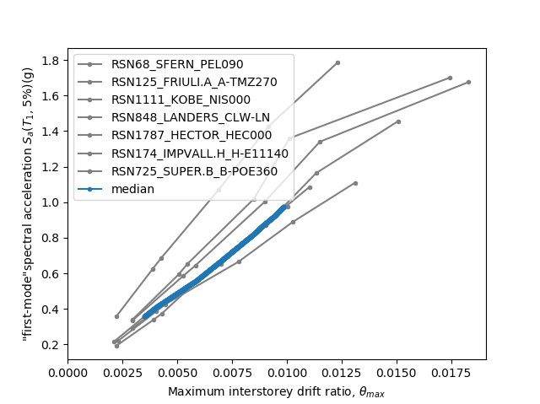
Normal Side

